Slide 1
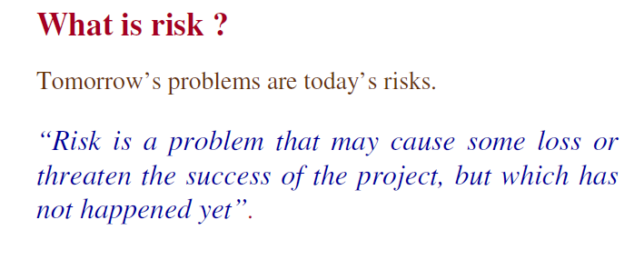
SOFTWARE ENGINEERING
Dr Prabhat Kumar Vishwakarma

Slide 2
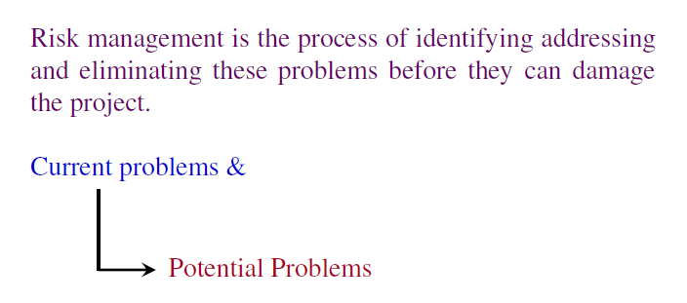
SOFTWARE ENGINEERING
Dr Prabhat Kumar Vishwakarma

Slide 3
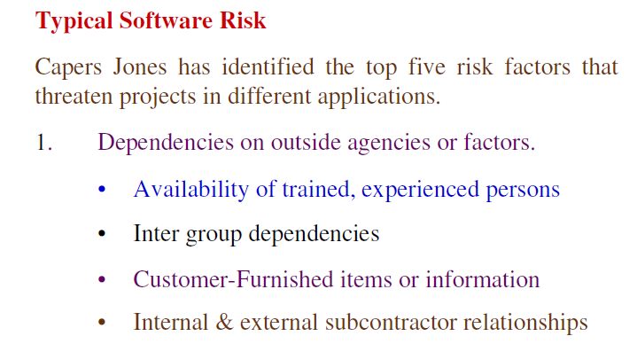
SOFTWARE ENGINEERING
Dr Prabhat Kumar Vishwakarma

Slide 4
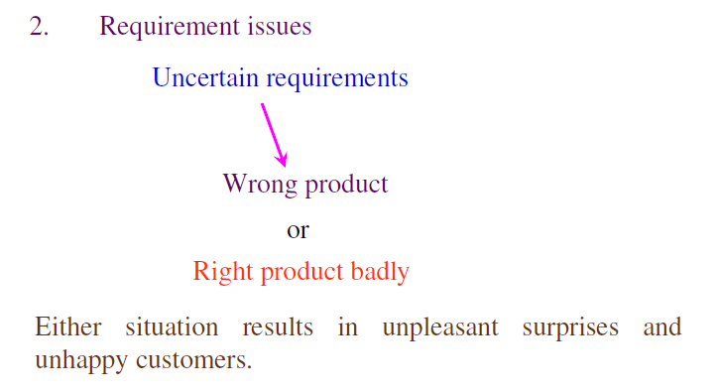
SOFTWARE ENGINEERING
Dr Prabhat Kumar Vishwakarma

Slide 5
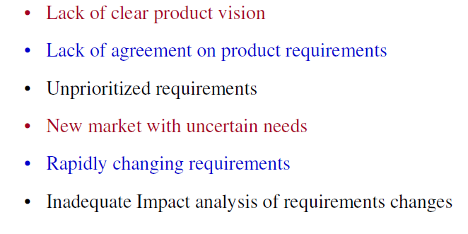
SOFTWARE ENGINEERING
Dr Prabhat Kumar Vishwakarma

Slide 6
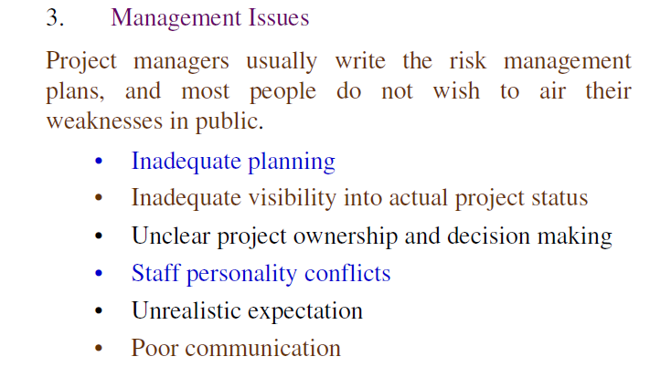
SOFTWARE ENGINEERING
Dr Prabhat Kumar Vishwakarma

Slide 7
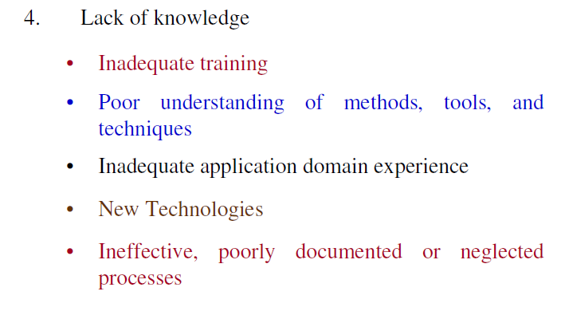
SOFTWARE ENGINEERING
Dr Prabhat Kumar Vishwakarma

Slide 8
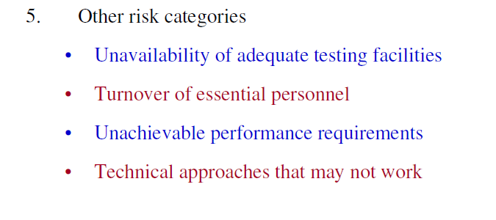
SOFTWARE ENGINEERING
Dr Prabhat Kumar Vishwakarma

Slide 9
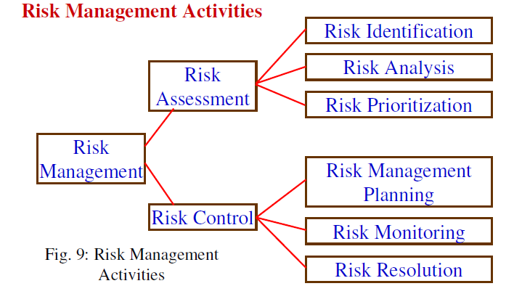
SOFTWARE ENGINEERING
Dr Prabhat Kumar Vishwakarma

Slide 10
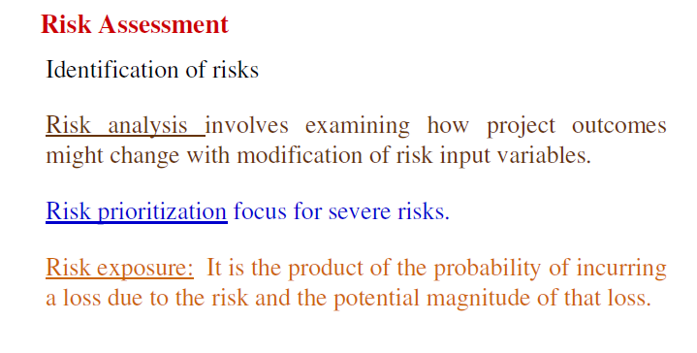
SOFTWARE ENGINEERING
Dr Prabhat Kumar Vishwakarma

Slide 11
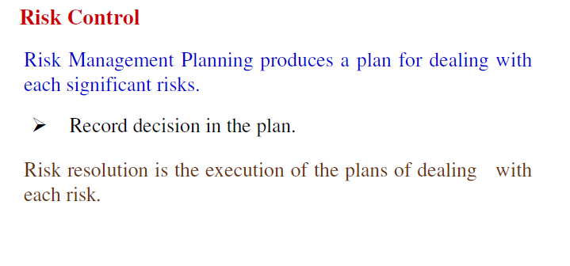
SOFTWARE ENGINEERING
Dr Prabhat Kumar Vishwakarma

